Slide 1

Financial Services Hack to Learn Near Real time Fraud Detection

Slide 2
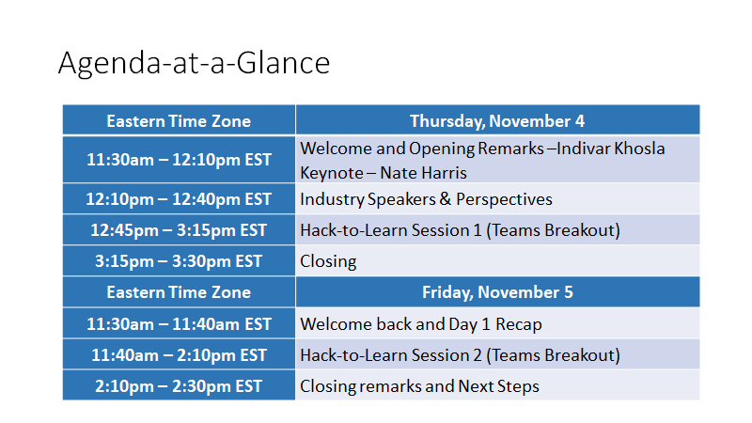

Slide 3
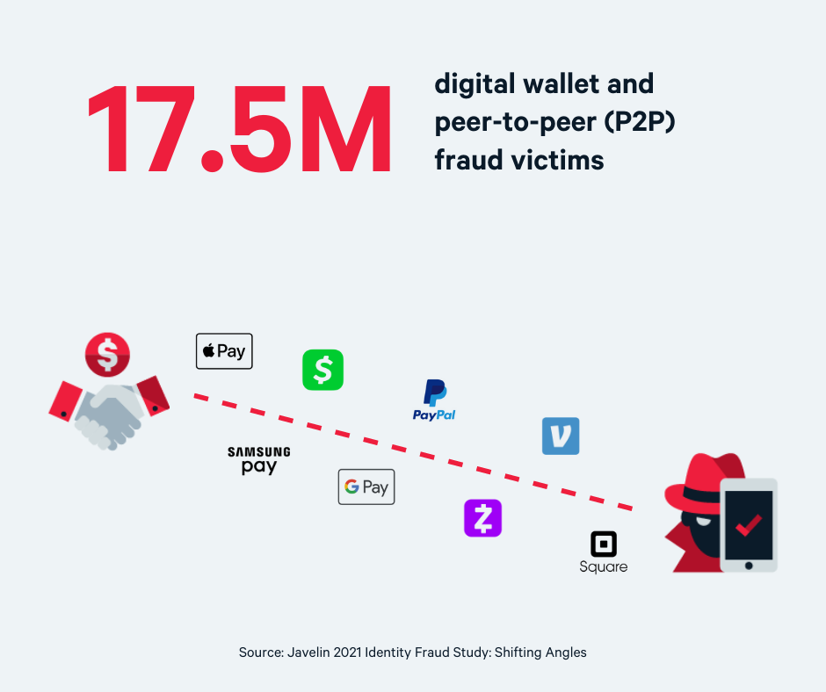
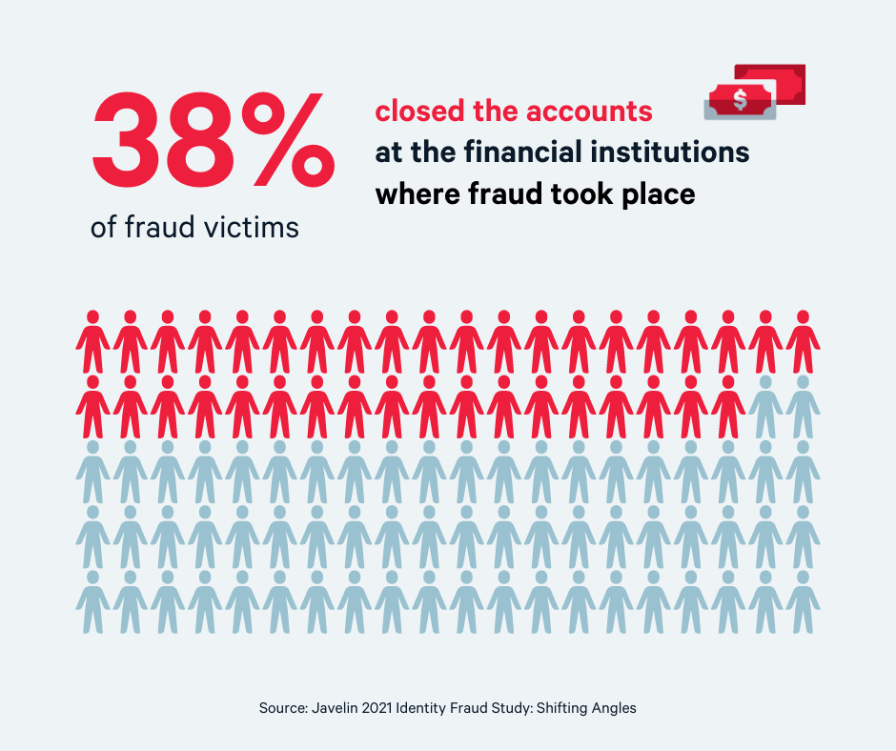
Importance of fraud
The global fraud detection and prevention market was valued at USD 18.24 billion in 2020 and expected to reach USD 40.8 billion by 2026 and grow at a CAGR of 18.17% over the forecast period (2021-2026).

Slide 4
1. Authorized push (or wire transfer) payment fraud
2. Account takeover fraud
3. Account opening fraud
4. Transaction payment fraud
5. Synthetic identity fraud
Types of fraud

Slide 5
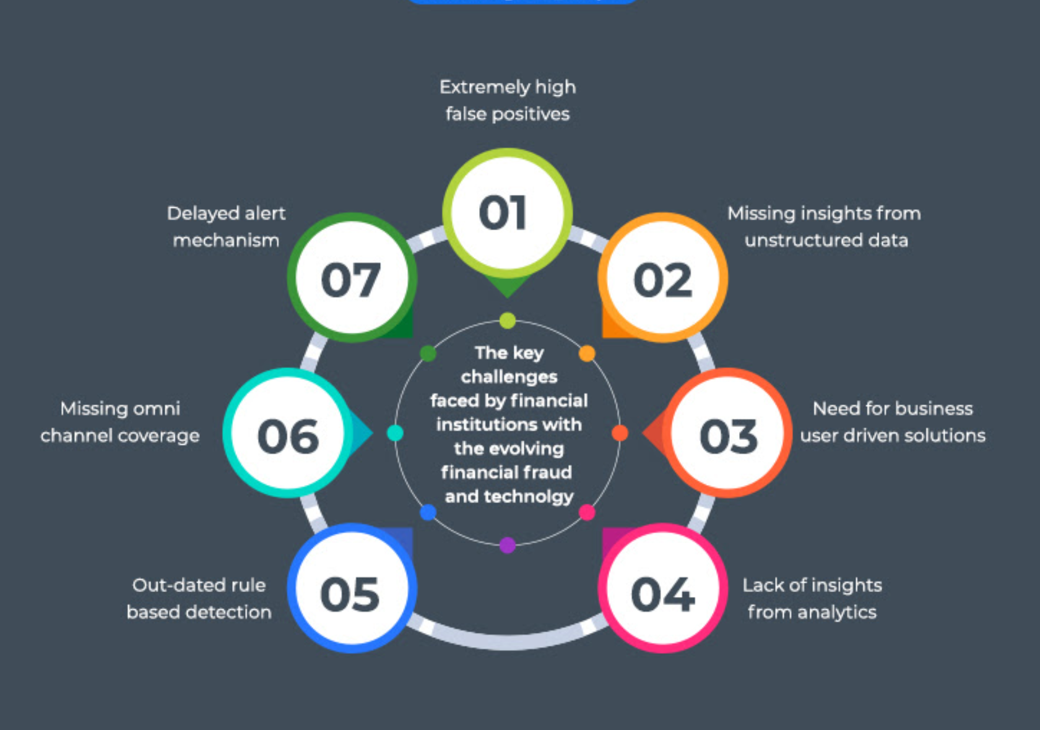
Fraud detection challenges for financial institutions

Slide 6
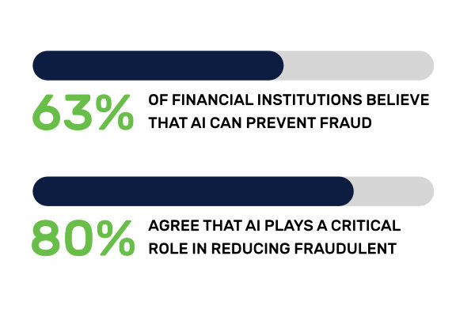
ML and AI for Fraud detection

Slide 7
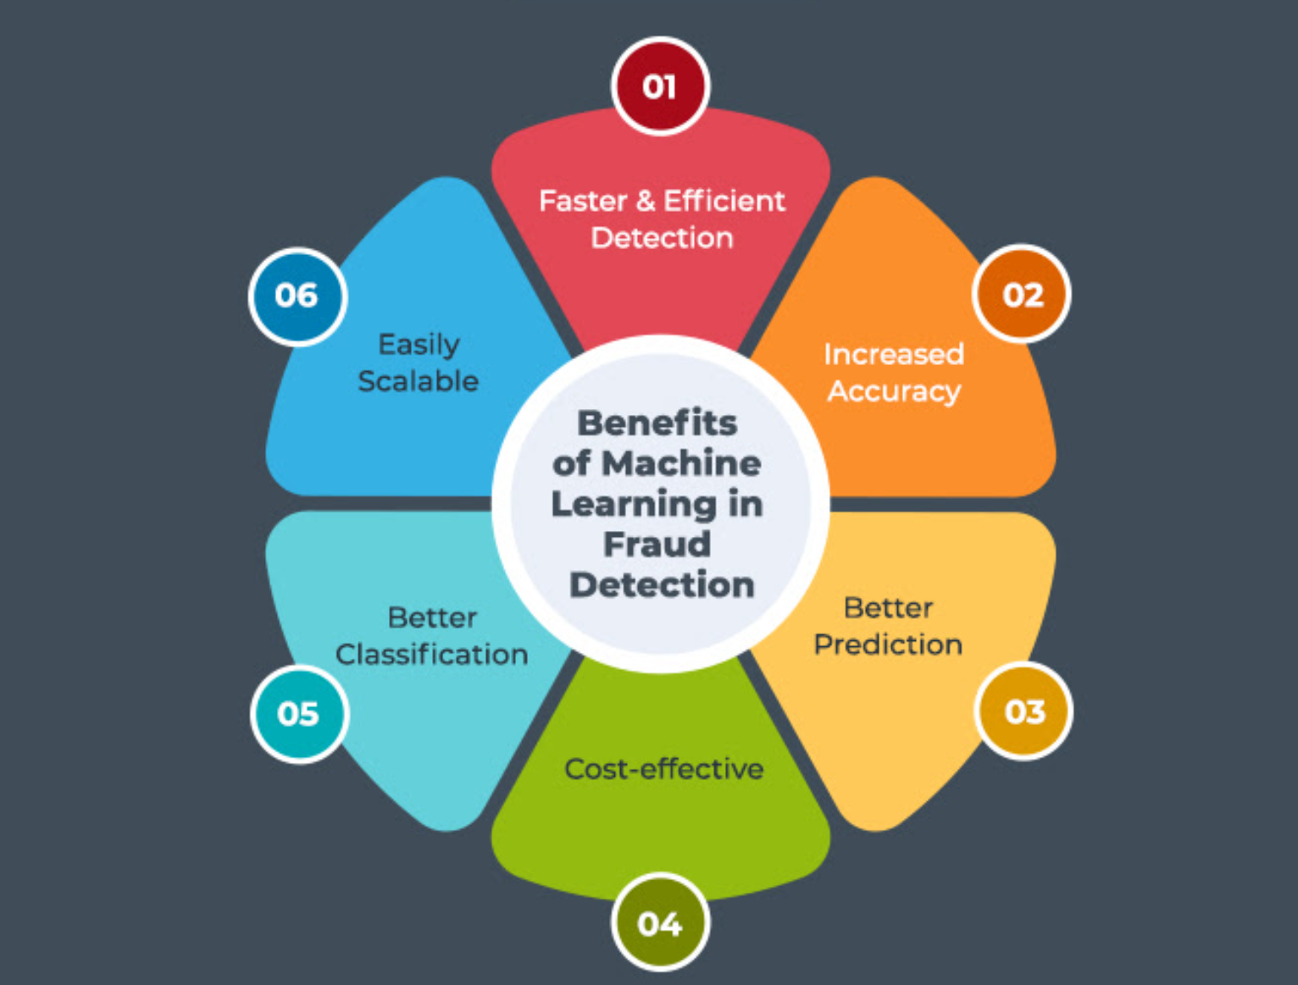
Why ML and AI for Fraud detection

Slide 8
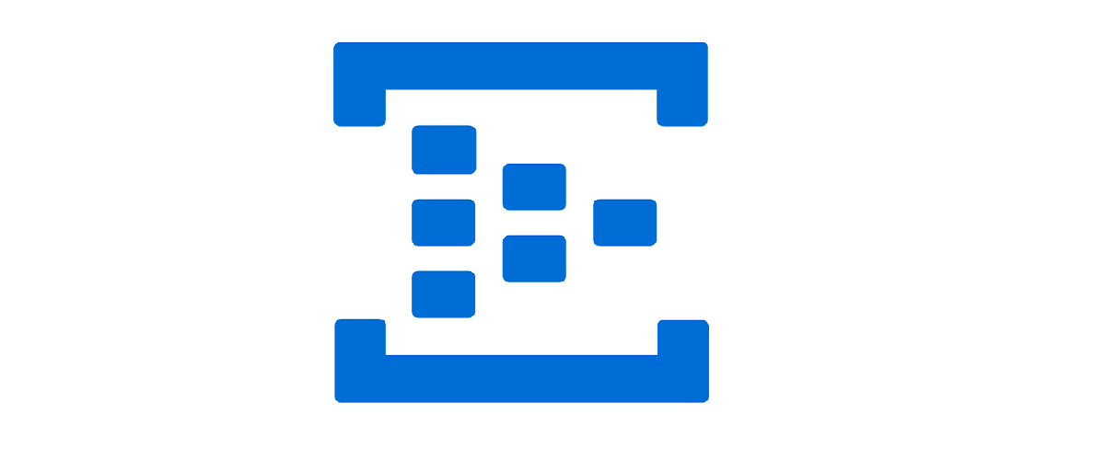




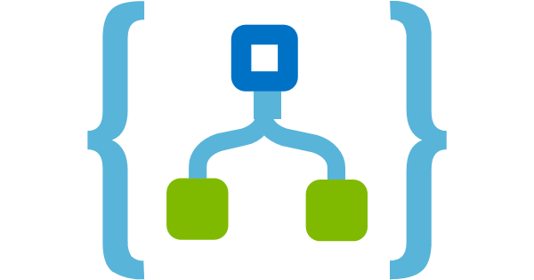

Challenge 1: Fraud detection and near real time reporting
Logic app
Ingest
Serve
Consume
Data Source
User
Cosmos HTAP
Synapse Link
To Cosmos Analytical store
Synapse Analytics
Power BI
To Cosmos
Transactional store
Cosmos
Transactional
Data
Azure ML

Slide 9






Many Hats of a data driven Organization
Responsible for business needs and outcomes
Responsible for training AI models
Responsible for Process automation and using ML model
Responsible for designing reports
Responsible for end to end testing
Business Owner
Data Scientist
Data Engineer
BI Developer
End to End Acceptance

Slide 10

Event format
All participant will wear a dawn different personas and complete the subset of challenges.
This hack to learn has 5 challenges corresponding to 5 different personas.
Each challenge has detailed objectives – to complete a challenge
Complete the acceptance criteria
Post relevant details on the channel chat
Update the status on the Poll present in the chat
For each challenge, the coach will give you a technology overview and walkthrough.
You would also be provided with detailed instructions if needed.
Detailed instructions can be downloaded from this github location.
If you are stuck or have immediate questions raise your hand and one of the coaches will assist you.

Slide 11
Challenge 1: Fraud and real time reporting
Business Owner
Data Engineer
Logic app
Ingest
Serve
Consume
Data Source
User
Cosmos HTAP
Synapse Link
To Cosmos Analytical store
Synapse Analytics
Power BI
To Cosmos
Transactional store
Cosmos
Transactional
Data
BI Developer
End to End Acceptance
Azure ML
Data Scientist

Slide 12
Technology Check

Slide 13
Hat 1
Objectives
Understand the business context of the challenge
Define high level expectations of the project
Acceptance criteria
Business owner write a short summary of project goals for the IT team.
Business Owner
Est. time 15 mins

Slide 14
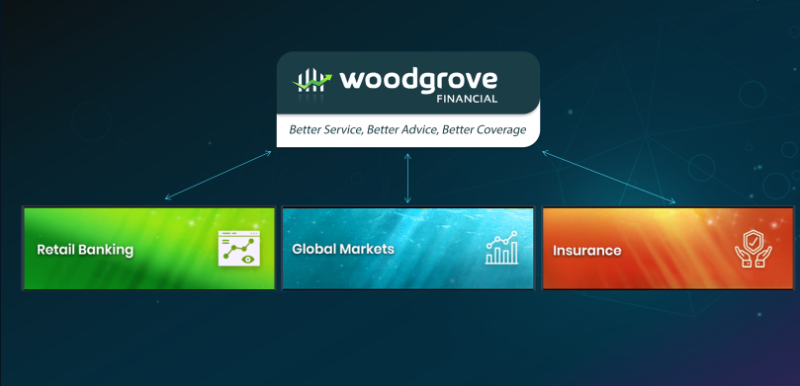
Case Study
Woodgrove Financial are a global Financial Conglomerate, with multiple operational arms.
Headquartered in New York, they are operating in 30+ cities all over the world. But their growth is currently stalled.
They aim to increase revenue, maximize active customers, and improve their public image by leveraging near real-time data and Predictive Analytics.
As part of this hackathon, you will be presented with business challenges that Woodgrove’s banking vertical is trying to solve through Azure technologies.
As solution provider your aim is to build an end-to-end MVP to solve these challenges.

Slide 15

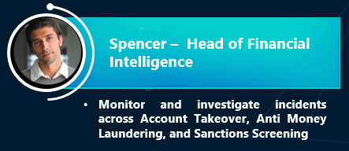
Case Study: Fraud and near real time reporting
As head the head of financial intelligence, Ryan is constantly looking for ways to recognize and prevent fraud as soon as possible.
With the rise in cybercrimes Spencer has leant that, but he needs to find a way operationalize this data to act on detected fraud in near real time.
Many of real time use cases are housed in OLTP systems and the reports are available only after ETL batch processing. Ryan is looking to create a real time dashboard that can display this information in near real time.

Slide 16

Before you throw your hat
Post the output artifacts on the group chat
Submit your response to the pole on the group chat
Post any open questions on the chat

Slide 17
Hat 2
Objectives
Understand the available data
Run Automated Machine learning on the data
Acceptance criteria
ML model for fraud detection is available to be used by data engineer
Understand challenges and outcome of initial model
Use remediation techniques for a better model
Participant writes a small summary about the model for the data engineer
Data Scientist
Est. time 90 mins

Slide 18

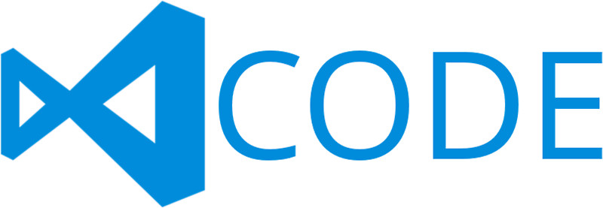
Machine Learning
Typical E2E Process
Prepare
Experiment
Deploy
…
Prepare Data
Build model (your favorite IDE)
Train & Test Model
Register and Manage Model
Build Image
Deploy Service
Monitor Model
Orchestrate

Slide 19





Machine Learning on Azure
Domain specific pretrained models
To reduce time to market
…
Vision
Speech
Language
Search
Familiar Data Science tools
To simplify model development
PyCharm
Jupyter
Visual Studio Code
Command line
Popular frameworks
To build advanced deep learning solutions
Pytorch
TensorFlow
Scikit-Learn
Onnx
Productive services
To empower data science and development teams
Azure Databricks
Azure Machine Learning
Machine Learning VMs
Powerful infrastructure
To accelerate deep learning
CPU
GPU
FPGA
From the Intelligent Cloud to the Intelligent Edge

Slide 20
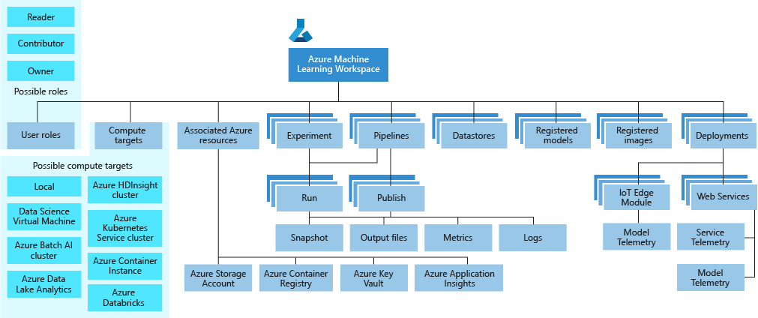
Introduction to Azure Machine Learning

Slide 21
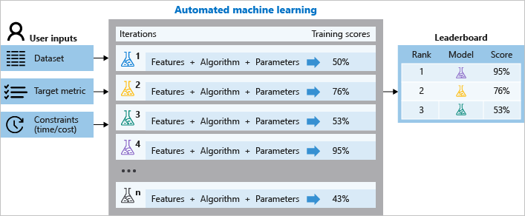

Slide 22
Objectives
Consume Machine learning model for real time fraud detection
Trigger notifications for suspected transactions
Acceptance criteria
Prepare the data for BI consumption
Share details of the analytical workspace for BI developer
Data Engineer
Est. time 90 mins

Slide 23

Introduction to Logic Apps
Automate workflows and orchestrate business processes easily
Out-of-the-box connectors reduce integration challenges
Connect and integrate data from the cloud to on-premises
B2B and enterprise messaging in the cloud
Powerful web-based workflow designer

Slide 24

Introduction to EventHubs
Simplify event-based app development with a publish-subscribe model
Simple HTTP-based event delivery and Kafka API
Build better, more reliable applications through reactive programming
Focus on product innovation

Slide 25



Introduction to CosmosDb
A globally distributed, massively scalable, multi-model database service
SQL
MongoDB
Table API
Column-family
Document
Key-value
Graph
Guaranteed low latency at the 99th percentile
Elastic scale out
of storage & throughput
Five well-defined consistency models
Turnkey global distribution
Comprehensive SLAs

Slide 26

Azure Synapse Analytics
Integrated data platform for BI, AI and continuous intelligence
Artificial Intelligence / Machine Learning / Internet of Things
Intelligent Apps / Business Intelligence
Designed for analytics workloads at any scale
Synapse Analytics
SaaS developer experiences for code free and code first
Experience
Azure Synapse Studio
Platform
Multiple languages suited to different analytics workloads
MANAGEMENT
Languages
MANAGEMENT
SQL
Python
.NET
Java
Scala
R
Integrated analytics runtimes available provisioned and serverless on-demand
SQL Analytics offering T-SQL for batch, streaming and interactive processing
Spark for big data processing with Python, Scala, R and .NET
SECURITY
Form Factors
SECURITY
PROVISIONED
ON-DEMAND
MONITORING
Analytics Runtimes
MONITORING
SQL
METASTORE
METASTORE
DATA INTEGRATION
Integrated platform services for, management, security, monitoring, and meta store
Azure
Data Lake Storage
Common Data Model
Enterprise Security
Optimized for Analytics
Data lake integrated and Common Data Model aware

Slide 27
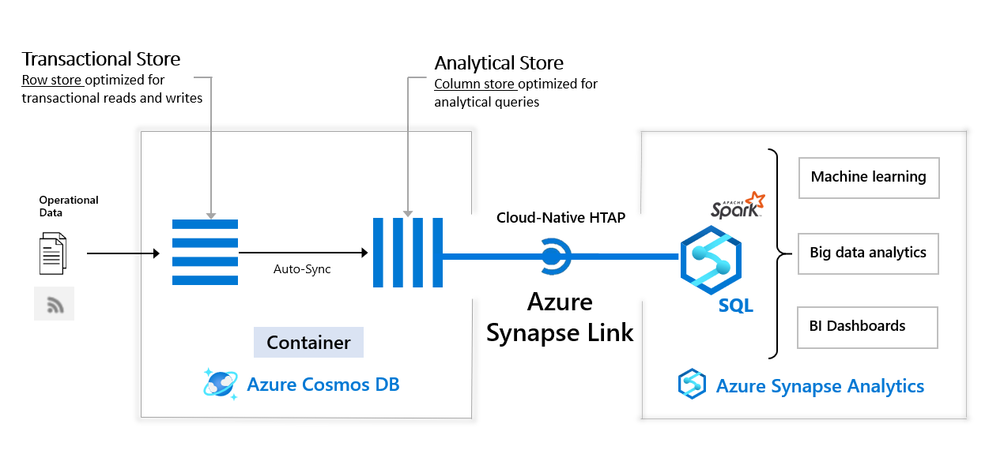
Introduction to Cosmos Synapse link
Reduced complexity with No ETL jobs to manage
Near real-time insights into your operational data
No impact on operational workloads
Elastic and cost effective

Slide 28
Objectives
Connect to analytical store
Build intelligent reports to visualize the data
Acceptance criteria
BI Developer
Fraud insights are available in near real time on the PowerBi dashboard

Slide 29

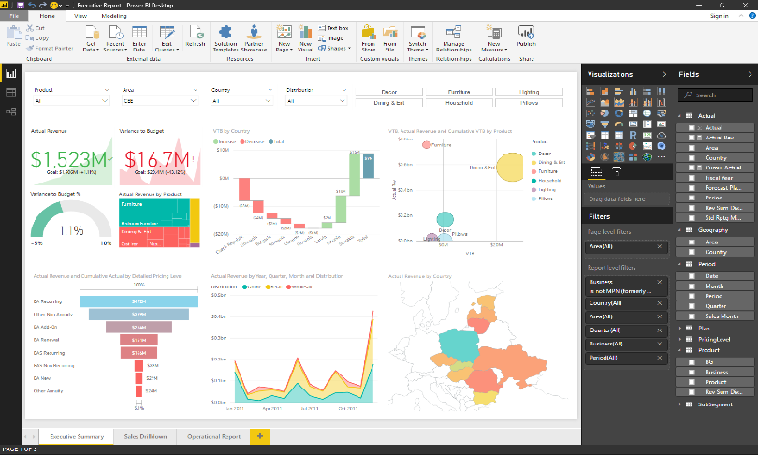
Introduction to PowerBI
Get your data
Analyze
Visualize
Publish
Collaborate

Slide 30
Objectives
Test end to end project with real time data
Acceptance criteria
End to End Acceptance
Fraud insights are available in near real time on the PowerBi dashboard

Slide 31
Fin.

